Slide 1



IHE Devices – SDPi Supplement
Introduction & Overview
<date> 2020
SDC is a registered trademark of OR.NET
(Version 1.2 2020.10.30A)

Slide 2
IHE Germany – SDC / SDPi Plug-a-Thon – Briefing
IHE Basics - Why profile?
From ISO/IEEE 11073 SDC to IHE SDPi TF to PATs & CATs
Orientation Tour: IHE Technical Framework & SDPi Profiles
IHE SDPi Profile Option Specifications
IHE SDPi TF-2 Transactions & MDPWS Messaging
IHE SDPi TF-3 SDC/BICEPS Content Modules & Specializations

Slide 3
First … Term Usage & Assumptions
SDC Service-oriented Device Connectivity Family of ISO/IEEE 11073 SDC standards Assumption: PAT participants have a working understanding of SDC
SDPi Service-oriented Device Point-of-care Interoperability Set of (4) IHE technical framework profiles based on ISO/IEEE 11073 SDC standards Assumption: PAT participants may have some working knowledge of IHE & TF profiles
PAT Plug-a-thon IHE testing event intended for early, informal exploration of new tech & new profiles Assumption: PAT participants may have background in “hackathons”, plugfests, etc.
CAT Connectathon IHE formal interoperability testing event for published profiles; includes independent monitors, test management tooling; published results Assumption: PAT participants may have background in formal test invents

Slide 4
Second … Profiles? Why?!
IHE Profile A technical specification that constrains a set of general open standards for application to a specific interoperability or integration need (described by a set of use cases) ¹
Why profiles?
As users and implementers agree how to use standards to address specific integration needs, optionality must be minimized, coordinated usage of multiple standards considered, and national / regional allowances factored
Isn’t a well architected family of standards sufficient?
The needs of an implementation community are often both narrower than the set of possible applications that are covered by foundational / core standards, such as ISO/IEEE 11073 SDC, as well as broader in scope requiring additional standards to be integrated.
¹ Not to be confused with an HL7 FHIR Profile, which is similar in concept but very different in application

Slide 5
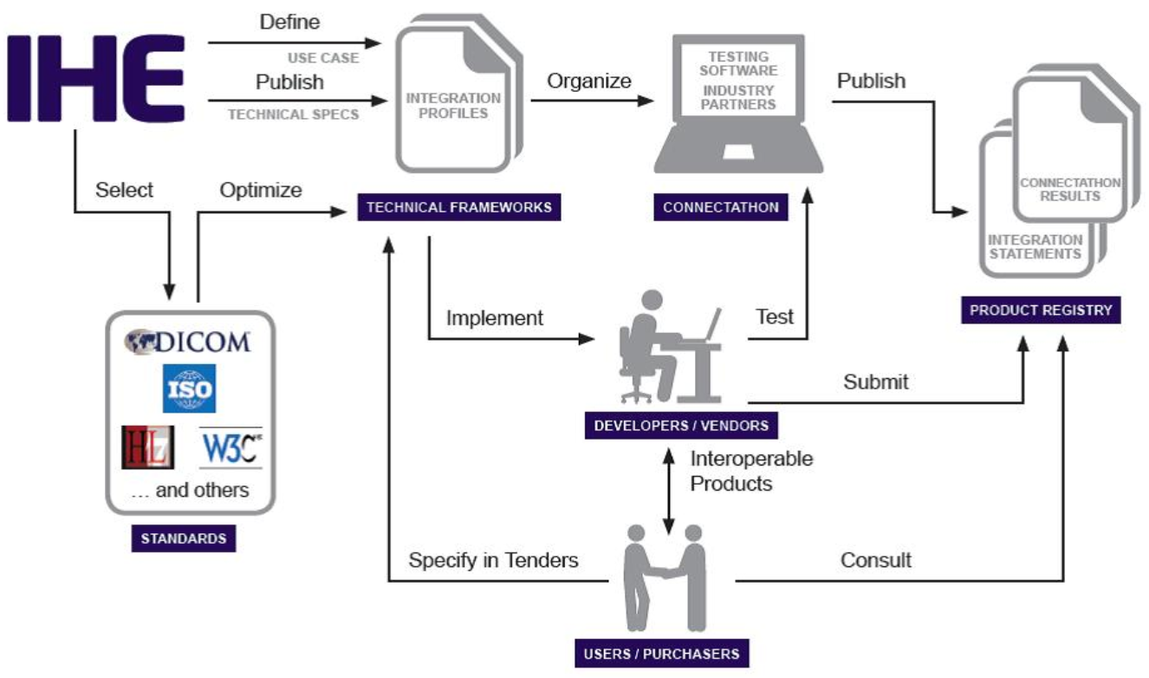
IHE Process Overview
Source: https://www.ihe.net/about_ihe/ihe_process/

Slide 6
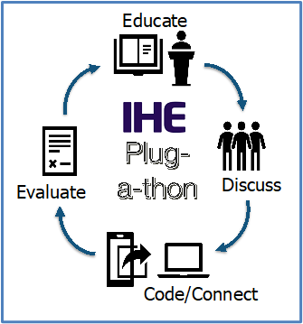
IHE Plug-a-thon (PAT) Basics
IHE Testing Events –
Pathway to CA & Certification!

Slide 7
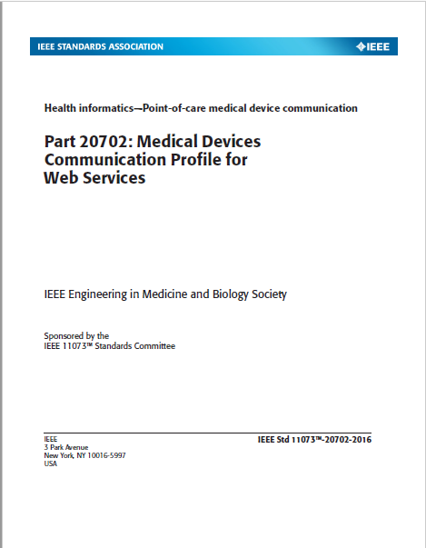
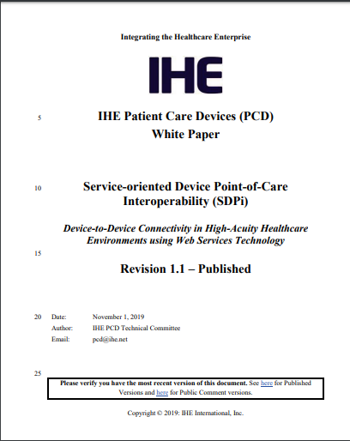
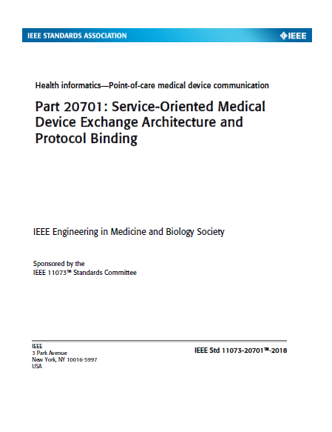
Orientation Tour: IHE TF & SDPi Profiles
2019 SDPi paper established rationale and strategy for profiling ISO/IEEE 11073 SDC in IHE Technical Framework profile specifications.
https://www.ihe.net/uploadedFiles/Documents/PCD/IHE_PCD_WP_SDPi_Rev1-1_Pub_2019-11-01.pdf
https://wiki.ihe.net/index.php/SDC@IHE_White_Paper

Slide 8
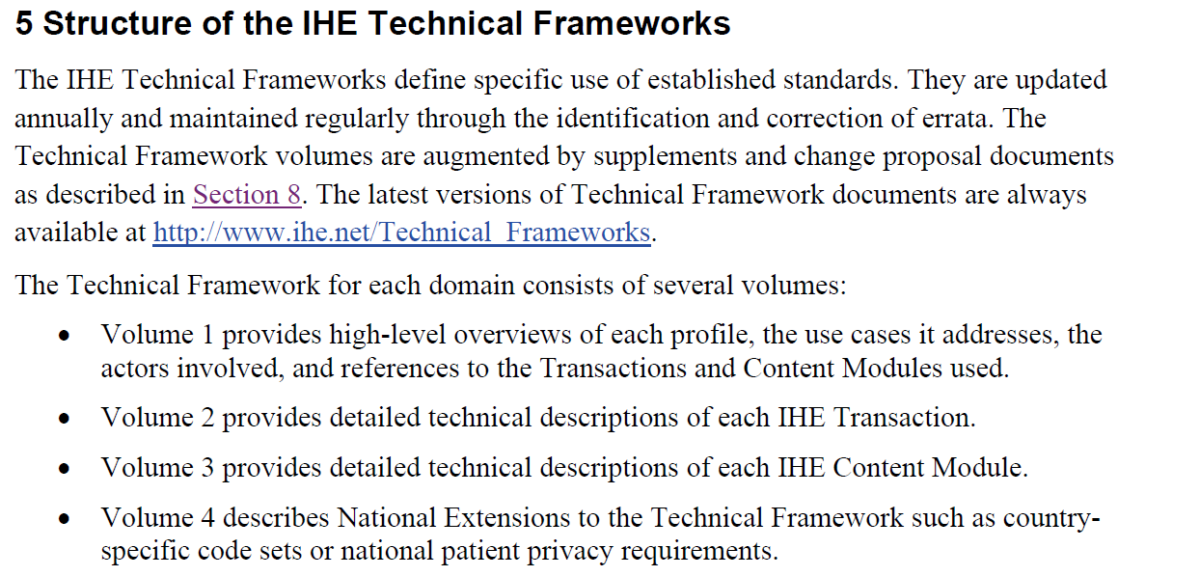
Orientation Tour: IHE TF & SDPi Profiles
Source: https://www.ihe.net/uploadedFiles/Documents/Templates/IHE_TF_General_Introduction.pdf

Slide 9
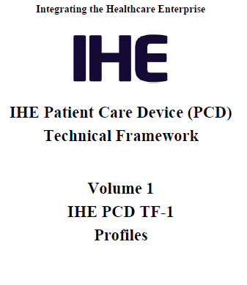
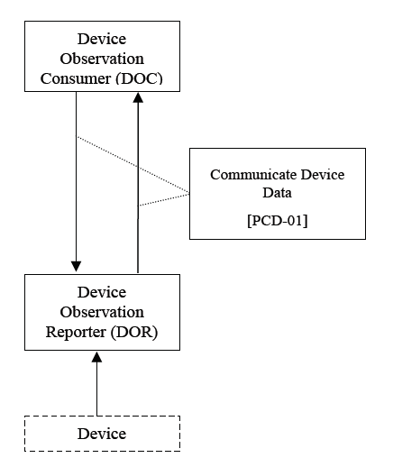
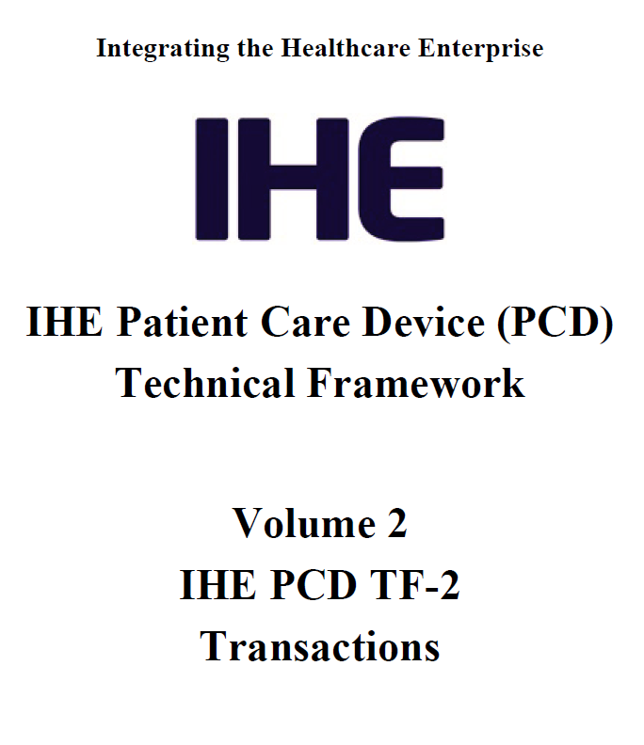
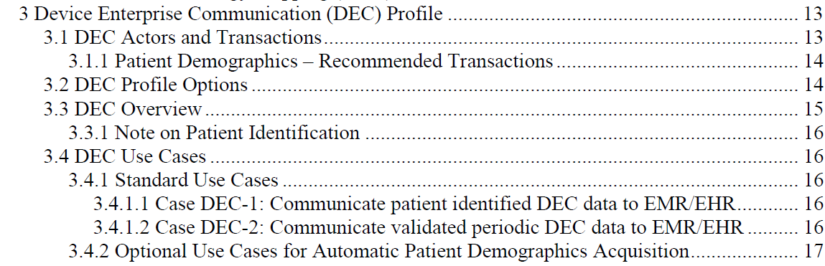
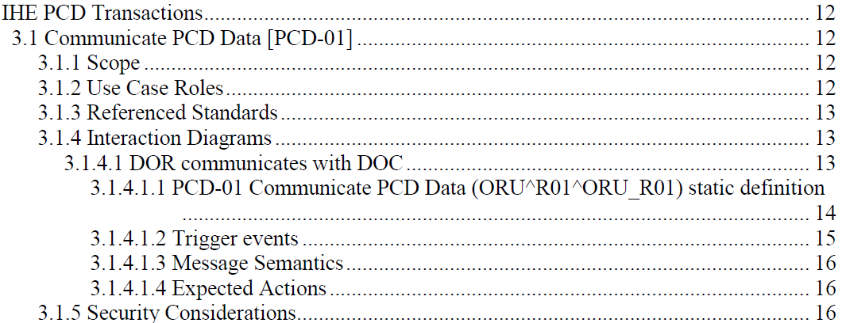
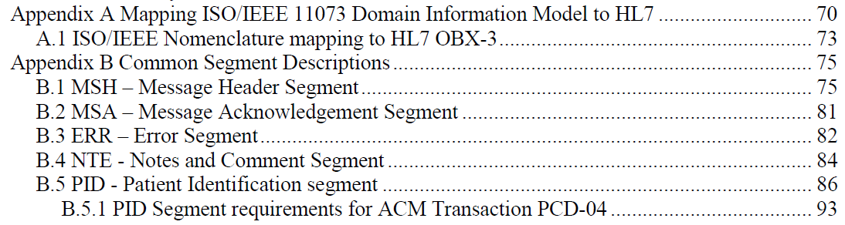
Orientation Tour: Example – IHE DEC Profile
TF-1 Profile calls out TF-2 Transaction(s) – may add usage constraints
TF-2 Common Transaction Message Elements are Specified Once in Appendices
NOTE: Only message profiling specifications included, relying on references to base message standards for all additional details.

Slide 10
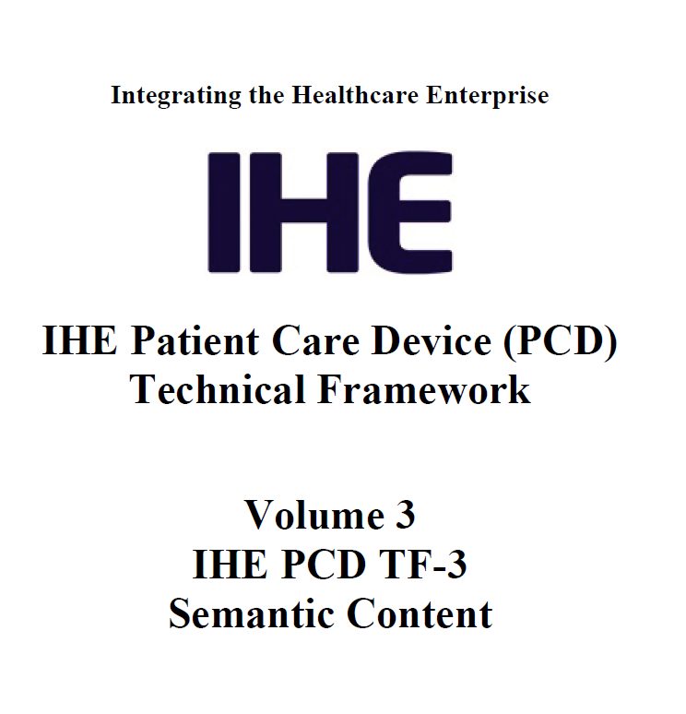
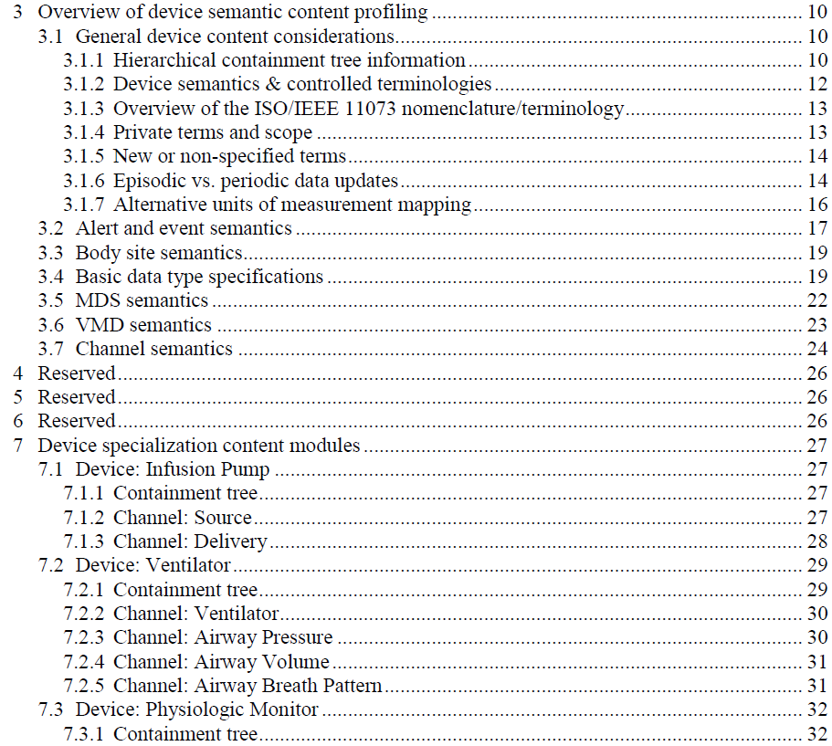
Orientation Tour: Example – IHE DEC Profile
General semantic content profiling specifications
TF-3 Bindings only generally referenced in DEC profile & DEV-01 Transaction
Device Specializations – Apply General to Specific types

Slide 11
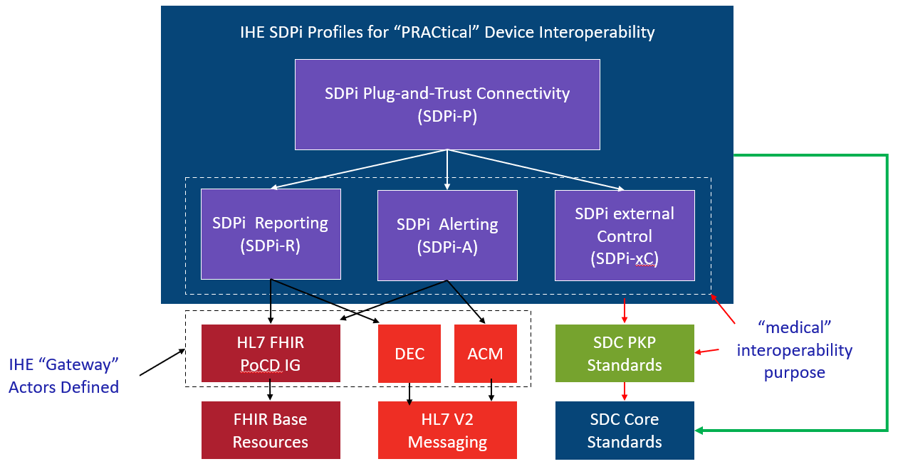
Orientation Tour: IHE TF & SDPi Profiles
Service-oriented Device Point-of-care Interoperability (SDPi)
Four profile specifications:
SDPi-P for Plug-and-Trust Interoperability
SDPi-R for Reporting Medical Information
SDPi-A for Alerting
SDPi-xC for External Controlling
Three IHE DEV TF Volumes:
TF-1 Profiles / use cases / actors / …
TF-2 Transactions / MDPWS messaging
TF-3 BICEPS content modules / device specializations
See draft SDPi Supplement Word Document for additional content detail & outline (https://github.com/IHE/sdpi-fhir/tree/master/SDPi%20%20Supplement/SDPi%20Rev%201.0)

Slide 12
Orientation Tour: From Volume 1 to 2 to 3
SDPi TF Supplement Vol.1 Integration Profiles
SDPi-P Profile
Profile Actors & Transactions & Content Modules
Profile Actor Options
Profile Overview (Concepts & Use Cases)
SES Considerations
SDPi-Reporting Profile …
SDPi-Alerting Profile …
SDPi-xControl Profile …
Appendix A: Requirements Management for Plug-n-Trust Interoperability
Appendix B: ISO/IEEE 11073 SDC Requirements Coverage
<including ISO/IEEE 11073 SDC ICS tables>
Appendix C: Device Point-of-care Interoperability Use Cases
<including Gherkin detail & links to Compendium etc.>
SDPi TF Supplement Vol.2 Transactions
DEV-23 Announce Network Presence
Scope
Actor Roles & Referenced Standards
Messages (at BICEPS level w/ links to Appendix A)
Protocol Requirements
SES Considerations
DEV-24 Discover Network Participants
…
DEV-44 Invoke Medical Control Services
Appendix A: ISO/IEEE 11073 SDC / MDPWS Message Specifications (Normative)
SDC/BICEPS to SDC/MDPWS Message Specifications
Messages for BICEPS Discovery Model
<specific MDPWS message links>
<example exchanges & library calls>
MDPWS Message Detail in Appendix
M:N Profiles & Transactions
See SDPi Supplement (1.0) document in the IHE sdpi-fhir Github repository for full details.

Slide 13
Orientation Tour: From Volume 1 to 2 to 3
SDPi TF Supplement Vol.1 Integration Profiles
SDPi-P Profile
Profile Actors & Transactions & Content Modules
Profile Actor Options
Profile Overview (Concepts & Use Cases)
SES Considerations
SDPi-Reporting Profile …
SDPi TF Supplement Vol.3 Content Modules
DEV Semantic Content Modules
General Device Content Considerations
…
SDC / BICEPS Semantic Content
DEV Specialization Content Modules
Device: Infusion Pump
…
SDC / BICEPS Content Module
Device: Ventilator …
Device: Physiologic Monitor …
Devices: Surgery … (new)
Devices: Anesthesia … (new)
Devices: Dialysis … (new)
SDPi TF Supplement Vol.2 Transactions
DEV-23 Announce Network Presence
Scope
Actor Roles & Referenced Standards
Messages (at BICEPS level w/ links to Appendix A)
Protocol Requirements
SES Considerations
DEV-24 Discover Network Participants
…
Bindings – General & Specific
See SDPi Supplement (1.0) document in the IHE sdpi-fhir Github repository for full details.

Slide 14
Orientation Tour: From 11073 SDC to SDPi
Initially, map to TF-3 DEV Content Modules / Device Specializations
Can include content before specializations published
Eventually, may inform IHE DEV Device-Specific Profiles
Pre-publication, will reference in SDPi SES sections (TF-1, -2 & -3)
Post-publication, can fully integrate requirements into SDPi (incl. TF-1 Appendix B conformance)
NOTE: (4) profiles are aligned with these (4) key purposes
SDC/BICEPS (-10207) Referenced in all (3) volumes (TF-1, -2 & -3)
SDC/SOMDA (-20701) Referenced in TF-1 & TF-2
SDC/MDPWS (-20702) Referenced primarily in TF-2 (esp. Apdx. A)

Slide 15
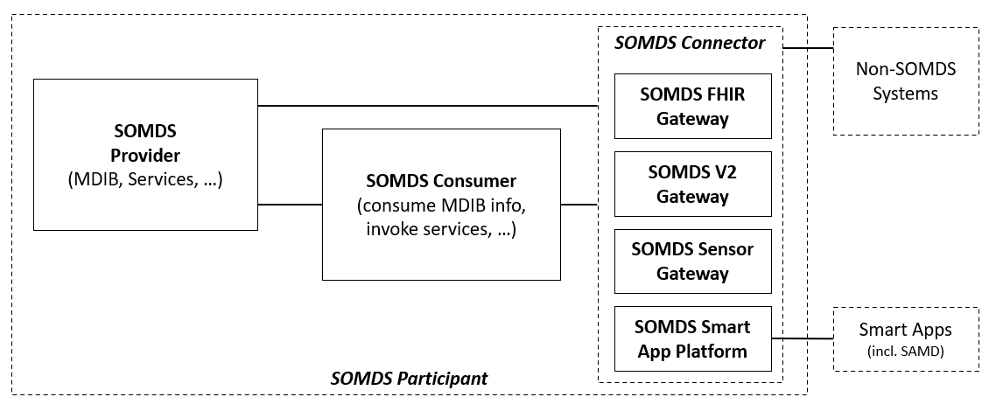
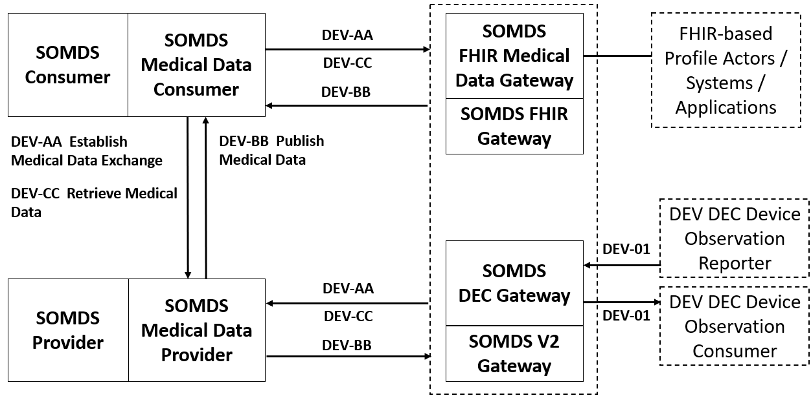
Orientation Tour: IHE Profile Actor Diagrams
SDPi-P Actor Diagram
IHE Actor
“information systems or components of information systems that produce, manage, or act on health information”
IHE Abstract Actor
Specifies behavior that is shared across / inherited by a set of IHE Actors (actor name in italics & dotted line around concrete actors)
Profile “External” Actor
Indicates actors that are outside the scope of the profile but interact with profile actors (dotted box) Note: actor may be defined in other profiles
SDPi-A Actor Diagram
IHE Grouped Actor
Indicates actors that integrate with other actors to provide their functionality (two rectangles joined side-by-side)

Slide 16
Orientation Tour: SDPi-P (Plug-and-Trust)
SDPi-P Actor Model
NOTE: SOMDS Participant actors may be devices, system applications, SAMD, “smart apps” …

Slide 17
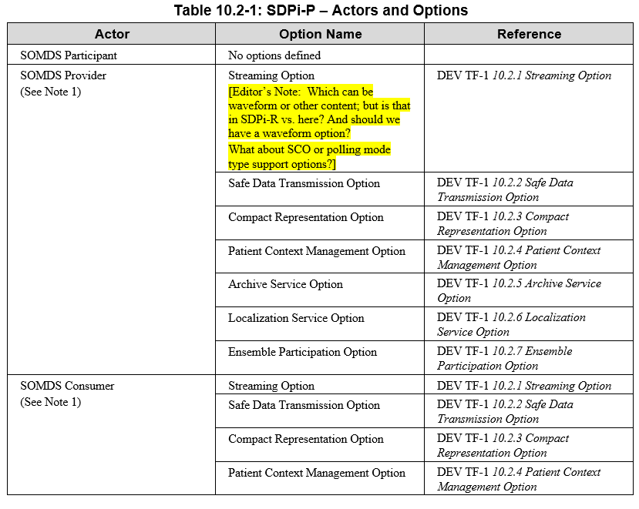
Orientation Tour: SDPi-P (Plug-and-Trust)
SDPi-P Actor Model
SDPi-P Options (partial)
Current Proposed Options
See SDPI Profile Option Specifications section for detail on each

Slide 18
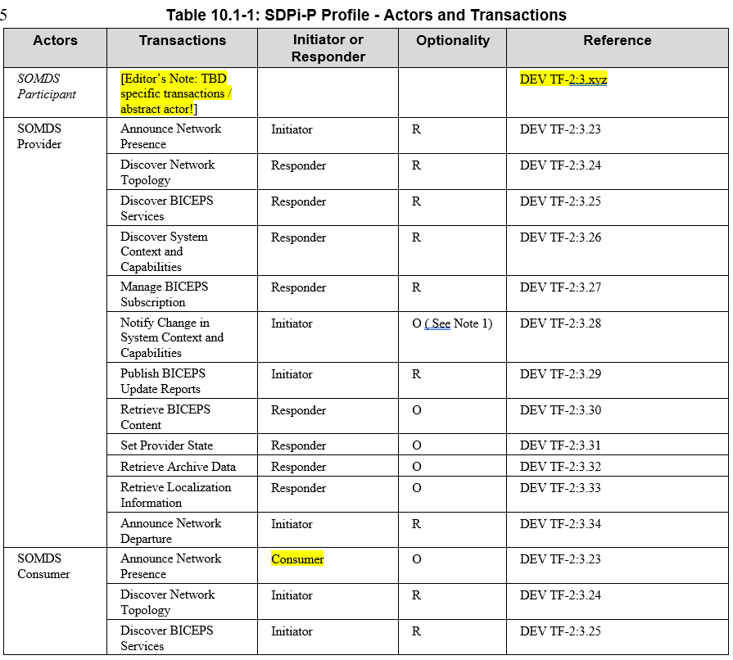
Orientation Tour: SDPi-P (Plug-and-Trust)
SDPi-P Actor Model
SDPi-P Transactions
See SDPI Transaction Specifications section for detail on each

Slide 19
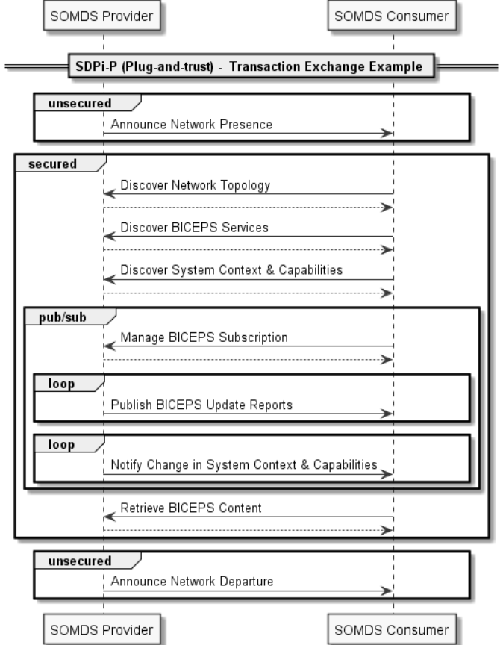
Orientation Tour: SDPi-P (Plug-and-Trust)
Example of an SDPi-P transaction exchange …
For a full set of profile-specific MDPWS sequence exchanges, see:
https://confluence.hl7.org/display/GP/SDPi+Technical+Framework+Models
NOTE: Definition of “BICEPS” abstraction level for SDPi transactions.

Slide 20
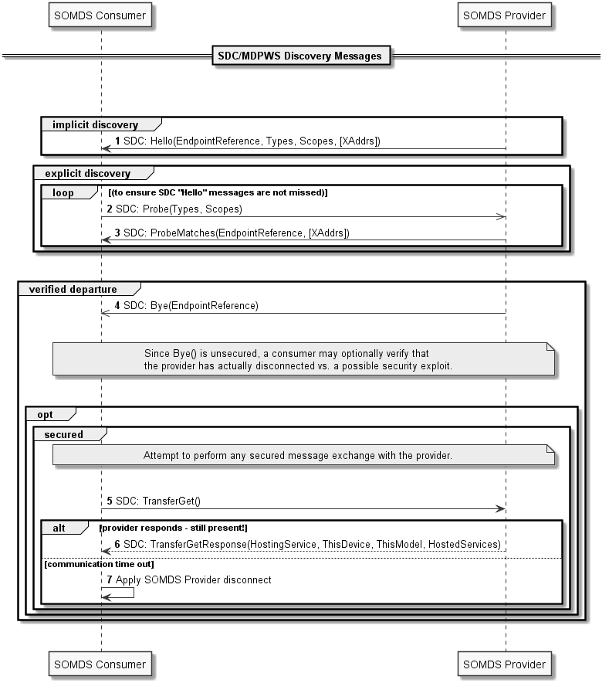
Orientation Tour: SDPi-P (Plug-and-Trust)
Example of an SDPi-P transaction MDPWS sequence
For a full set of profile-specific MDPWS sequence exchanges, see:
https://confluence.hl7.org/display/GP/SDPi+Technical+Framework+Models

Slide 21
Orientation Tour: SDPi-R (Reporting)
SDPi-R Actor Model
NOTE: Transactions are drawn to the dotted box around the gateways, indicating that they can be either Provider and / or Consumer SDPi-R actors
See SDPI Transaction Specifications section for detail on each

Slide 22
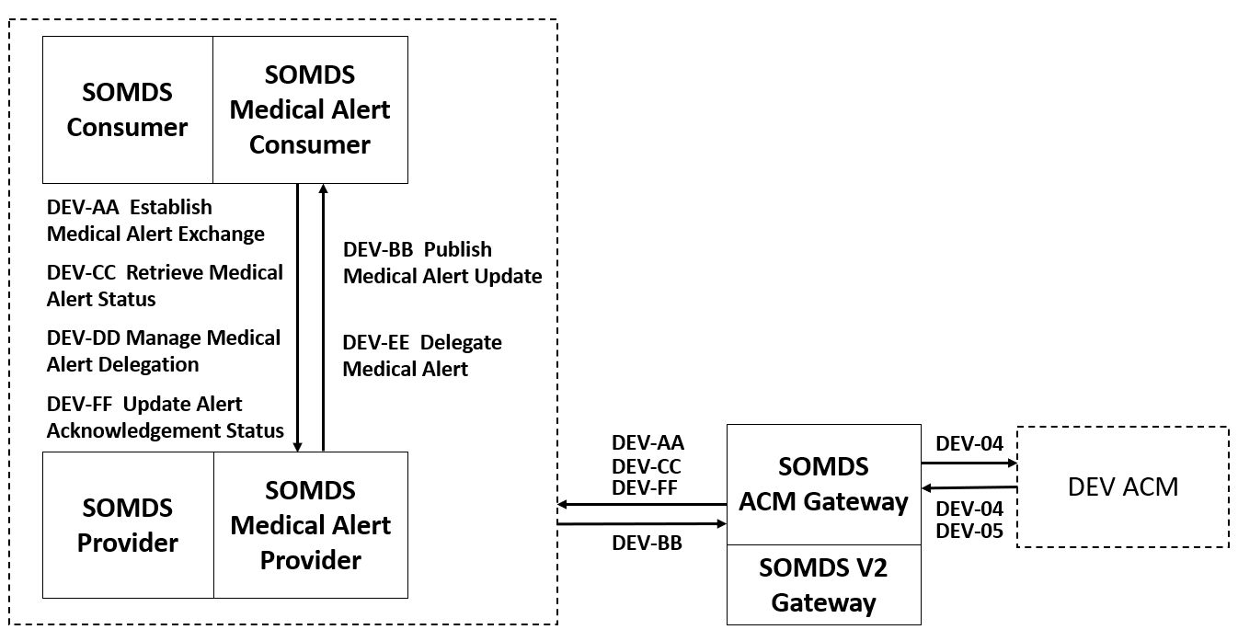
Orientation Tour: SDPi-A (Alerting)
SDPi-A Actor Model
See SDPI Transaction Specifications section for detail on each

Slide 23
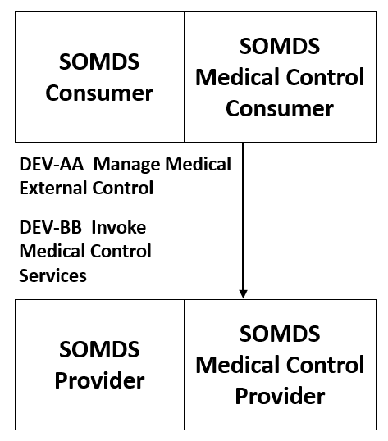
Orientation Tour: SDPi-xC (External Control)
SDPi-xC Actor Model
See SDPI Transaction Specifications section for detail on each

Slide 24
SDPi-P Option Specifications

Slide 25
SDPi-P Options: Streaming
Define related:
transactions,
MDPWS sequences,
SOMDA Constraints,
Content Module Bindings
SDPi 1.0 or subsequent?
…

Slide 26
SDPi-P Options: Safe Data Transmission
Define related:
transactions,
MDPWS sequences,
SOMDA Constraints,
Content Module Bindings
SDPi 1.0 or subsequent?
…

Slide 27
SDPi-P Options: Compact Representation
Define related:
transactions,
MDPWS sequences,
SOMDA Constraints,
Content Module Bindings
SDPi 1.0 or subsequent?
…

Slide 28
SDPi-P Options: Patient Context Management
Define related:
transactions,
MDPWS sequences,
SOMDA Constraints,
Content Module Bindings
SDPi 1.0 or subsequent?
…

Slide 29
SDPi-P Options: Archive Service
Define related:
transactions,
MDPWS sequences,
SOMDA Constraints,
Content Module Bindings
SDPi 1.0 or subsequent?
…

Slide 30
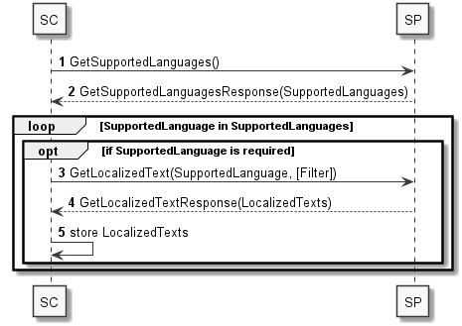
SDPi-P Options: Localization Service
Define related:
transactions,
MDPWS sequences,
SOMDA Constraints,
Content Module Bindings
SDPi 1.0 or subsequent?
…

Slide 31
SDPi-P Options: Ensemble Participation
Define related:
transactions,
MDPWS sequences,
SOMDA Constraints,
Content Module Bindings
SDPi 1.0 or subsequent?
…

Slide 32
SDPi TF-2 Transactions & MDPWS Messaging

Slide 33
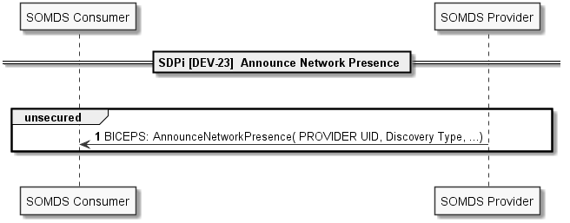
SDPi TF-2: DEV-23

Slide 34
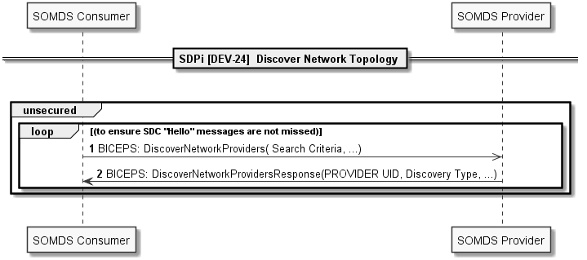
SDPi TF-2: DEV-24

Slide 35
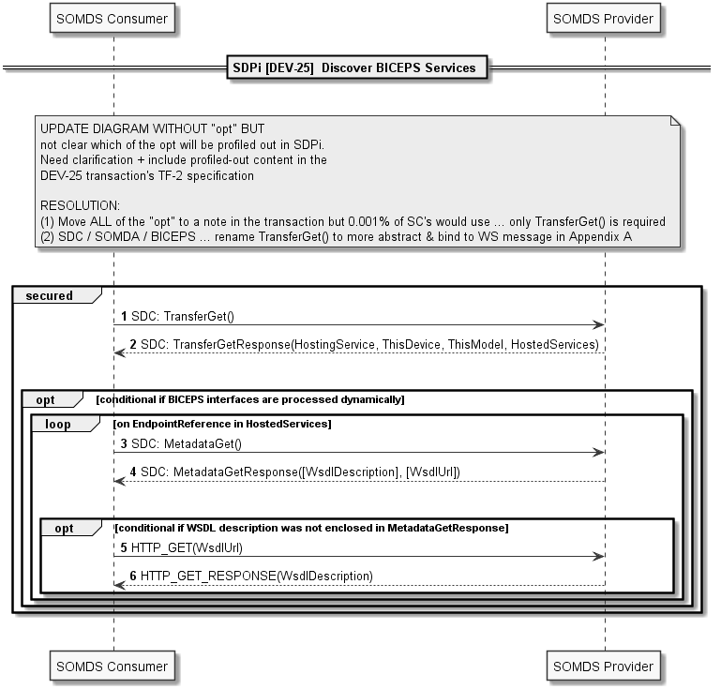
SDPi TF-2: DEV-25

Slide 36
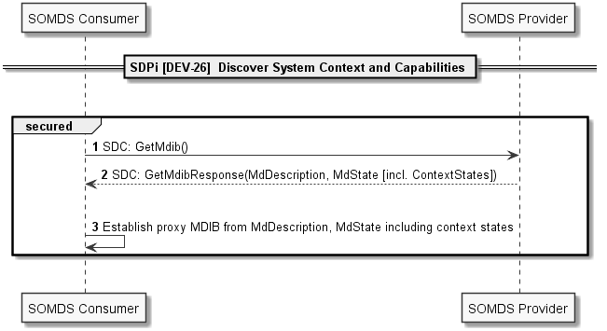
SDPi TF-2: DEV-26

Slide 37
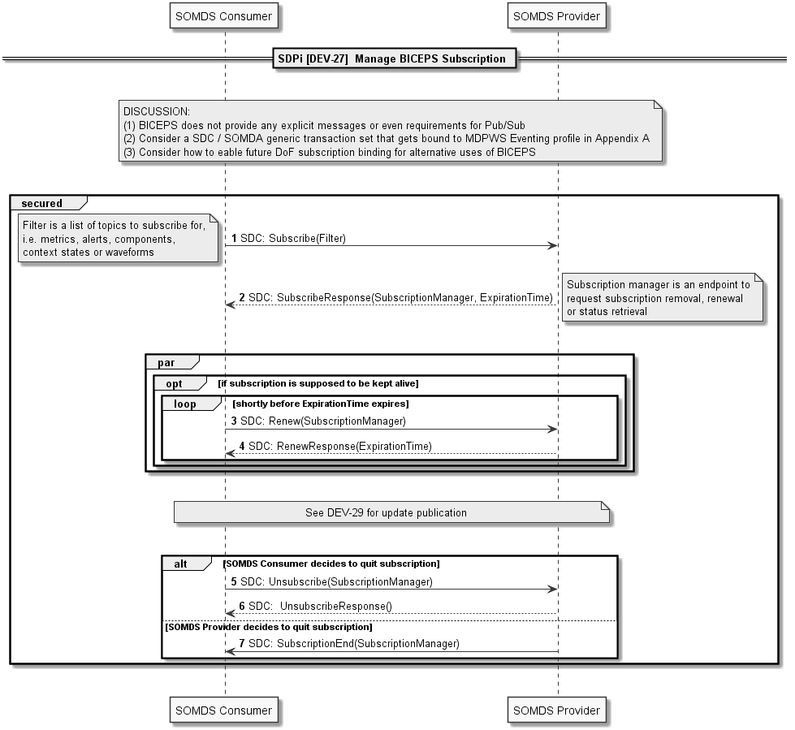
SDPi TF-2: DEV-27

Slide 38
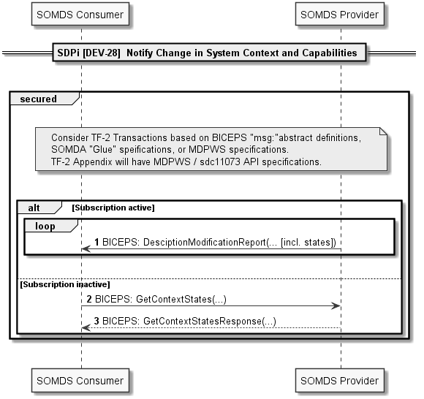
SDPi TF-2: DEV-28

Slide 39
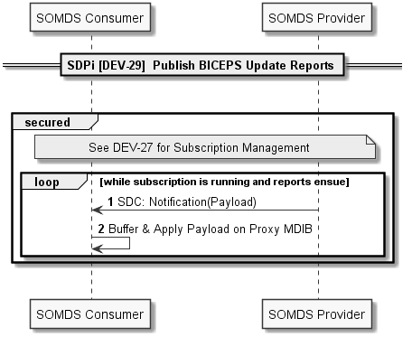
SDPi TF-2: DEV-29

Slide 40
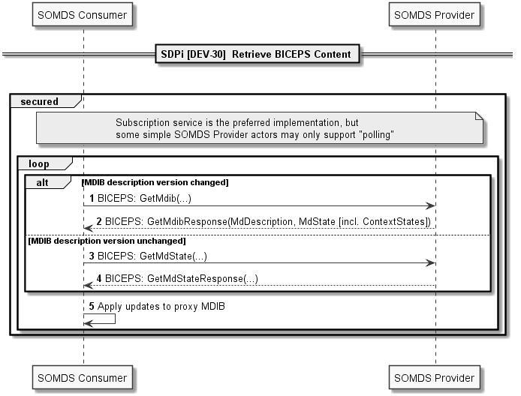
SDPi TF-2: DEV-30

Slide 41
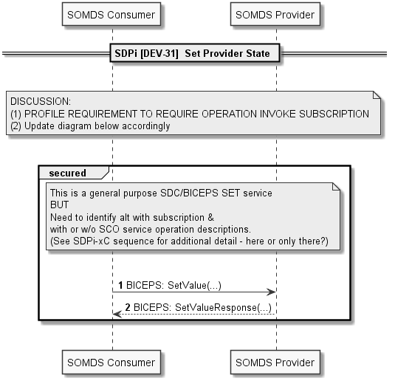
SDPi TF-2: DEV-31

Slide 42
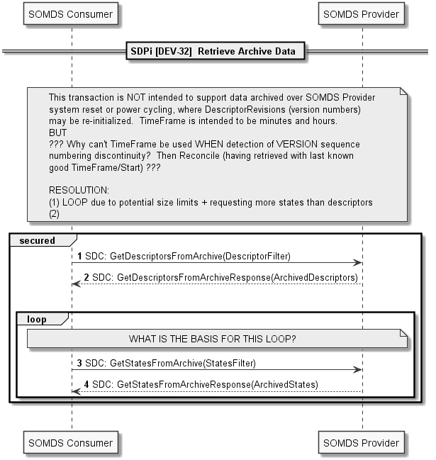
SDPi TF-2: DEV-32

Slide 43
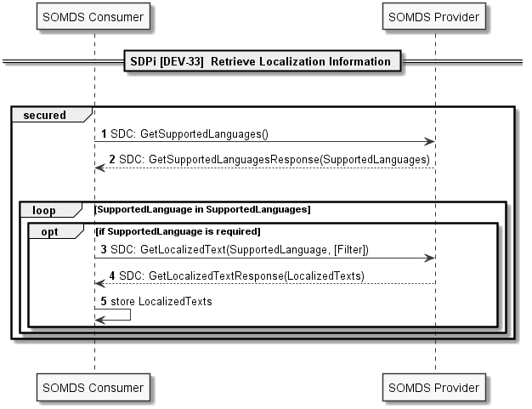
SDPi TF-2: DEV-33

Slide 44
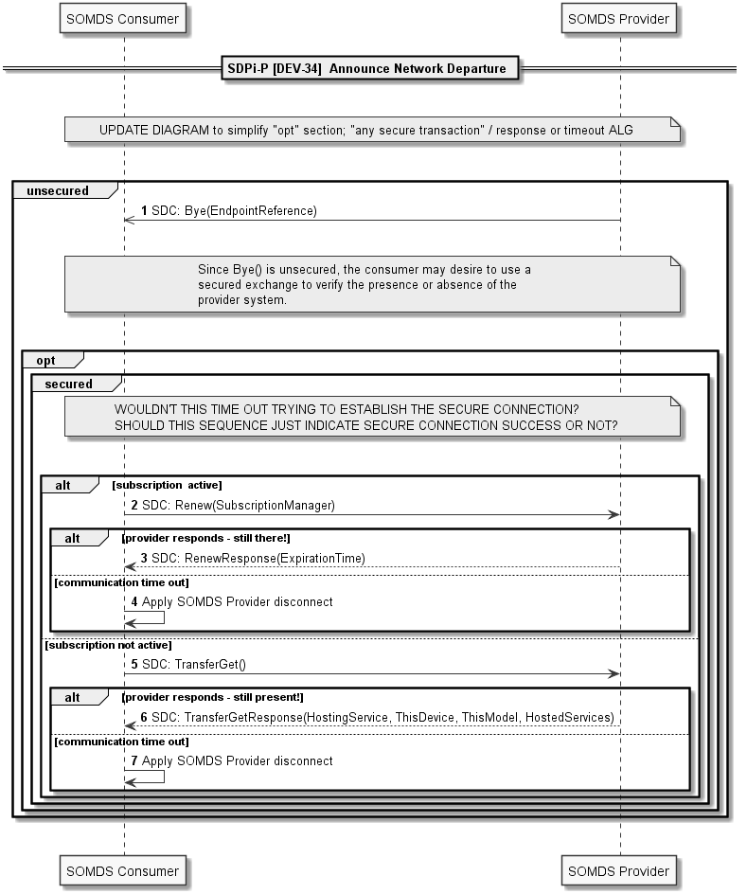
SDPi TF-2: DEV-34

Slide 45
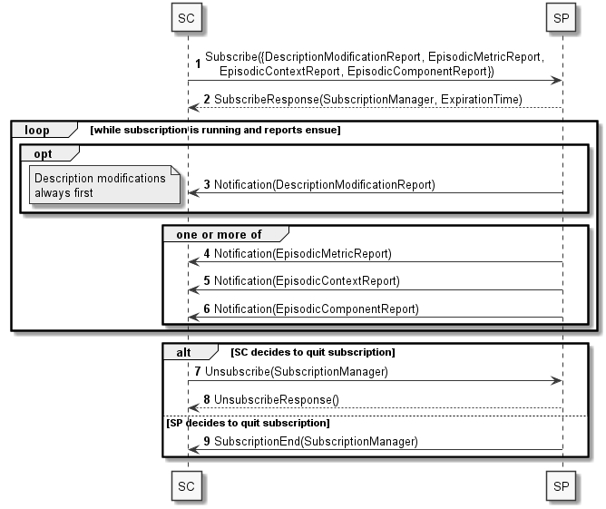
SDPi TF-2: DEV-35
3.35 Establish Medical Data Exchange [DEV-35]

Slide 46
SDPi TF-2: DEV-36
3.36 Publish Medical Data [DEV-36]

Slide 47
SDPi TF-2: DEV-37
3.37 Retrieve Medical Data [DEV-37]
Note this is a polled retrieve vs. pub/sub eventing

Slide 48
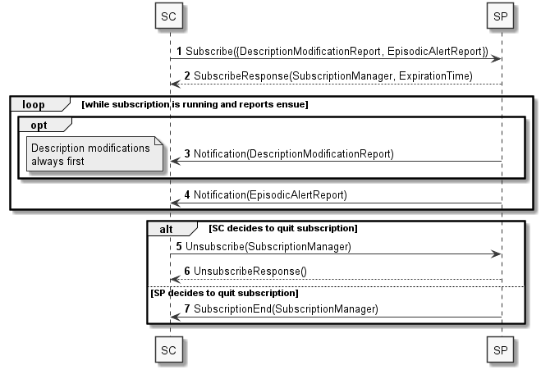
SDPi TF-2: DEV-38
3.38 Establish Medical Alert Exchange [DEV-38]

Slide 49
SDPi TF-2: DEV-39
3.39 Publish Medical Alert Update [DEV-39]

Slide 50
SDPi TF-2: DEV-40
3.40 Retrieve Medical Alert Status [DEV-40]

Slide 51
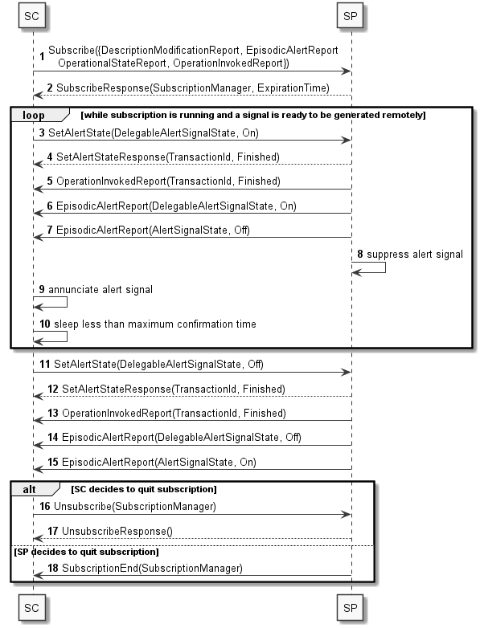
SDPi TF-2: DEV-41
3.41 Manage Medical Alert Delegation [DEV-41]

Slide 52
SDPi TF-2: DEV-42
3.42 Delegate Medical Alert [DEV-42]

Slide 53
SDPi TF-2: DEV-43
3.43 Update Alert Acknowledgement Status [DEV-43]

Slide 54
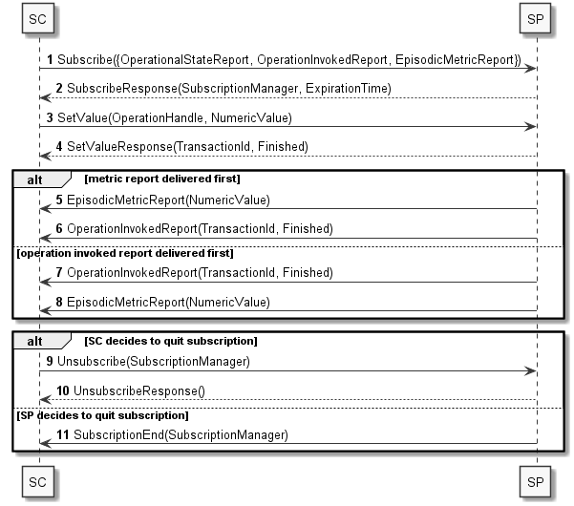
SDPi TF-2: DEV-44
3.44 Manage Medical External Control [DEV-44]

Slide 55
SDPi TF-2: DEV-45
3.45 Invoke Medical Control Services [DEV-45]

Slide 56
SDPi TF-3 SDC/BICEPS Content Modules & Specializations

Slide 57
SDPi TF-3: SDC/BICEPS Content Modules - General
Topics to be covered in the General BICEPS semantic profiling section:
Link to TF-1 SDPi-P Content Modules & same for other profiles?
Extension model
General (all device specializations)
SDPi 1.0 or subsequent?
… (see subsections in outline)

Slide 58
SDPi TF-3: SDC/BICEPS – Infusion Pumps
Topics to be covered in the BICEPS infusion pump profile section

Slide 59
SDPi TF-3: SDC/BICEPS – Physiologic Monitor
Topics to be covered in the BICEPS physiologic monitor profile section

Slide 60
SDPi TF-3: SDC/BICEPS – Ventilator
Topics to be covered in the BICEPS ventilator profile section

Slide 61
SDPi TF-3: SDC/BICEPS – Surgery Devices
Topics to be covered in the BICEPS surgery devices profile section

Slide 62
Additional
Information

Slide 63
Real-world Narrative: Isolation ICU
Pandemic Patients in an Isolation ICU – EUA Remote Control Narrative
In dealing with severely infectious patients, healthcare workers (HCWs) are at a significantly greater risk of infection than the overall population due to their frequency and time in contact with the infected patients. The HCWs will enter the patient room to administer care to the patient and manage the therapeutic equipment. This management of the patient’s therapy may require frequent device adjustments which may be delayed due to the need for the HCWs to protect themselves by donning PPE prior to entering the patient room and doffing the PPE upon leaving. This donning and doffing processes can exceed 15 minutes depending on the specific PPEs used. A recent study (Suen, 2018) reported times of 7 minutes for donning and 10 minutes for doffing, with the doffing process providing the opportunity for “considerable” self-contamination.
Infectious diseases confer a synergistic burden on and risk to the patient due to the requirements for isolating the patient (Abad et al., 2010) including poorer care and impaired coordination of care, (Mehrotra et al., 2013), significantly fewer HCW and family visits (relative to patients not on precautions) (Morgan et al., 2013), increased rate of adverse events (Stelfox et al., 2003) and increased depression (compared to other inpatients). (Day et al., 2011). The use of remote control and monitoring can be used to eliminate some treatment delays, reduce the infection risk to the HCW, and help preserve the limited supplies of PPE and improve patient care.
Critically ill patients with an infectious disease will often require monitoring with physiologic monitors and therapeutic support with ventilators and infusion pumps. As previously explained, entering the room to view parameters or adjust any settings can require 15 minutes for something that may take less than 1 minute. Medical devices that support open interoperability technology can provide remote access to view parameters and adjust settings thereby increasing efficiency, saving the costs of the PPE and most importantly increasing the safety of the HCW.
Source: Adapted from AAMI CR Proposal: “Emergency Use Guidance for Remote Control of Medical Devices"

Slide 64
Real-world Narrative: Isolation ICU
Pandemic Patients in an Isolation ICU – Scenarios?
For the purposes of this PAT, what scenarios are of greatest interest?
Participant Discovery / Security / Service Exchange?
Patient / Participant Association (Patient & Location & Workflow context establishment)?
Alert delegation / Alert Limit Adjustment / Alert confirmation / Silence ... ?
Which devices, systems, applications? Monitors, vents, pumps, central … others?
Integration with EHR or other system?
Use of IHE-based FHIR profiles for integration with non-SDPi / non-SDC SOMDS systems?
…
Other Use Cases / Scenarios? (e.g., surgery focused)

Slide 65
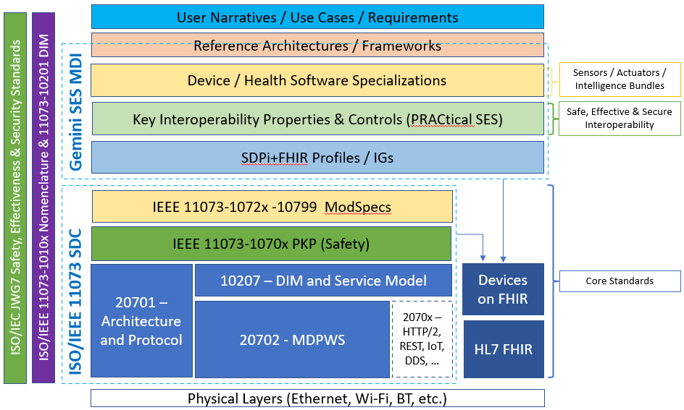
Hanging Gardens: After SDPi 1.0 …
NOTE: Profile Titles are notional – hopefully useful too!
Devices-In-Care (PDP) Profile
Device Specialization Profile
Surgery PoC Profile
ICU PoC Profile
MDIRA ICE Profile
SOMDS@home Profile
IHE (Official) Profile Types:
Transport, Content, Workflow
Or a combination of all (3)
Other types?
Architecture (SOA, MDIRA, SDC, ….?
Single domain / multi-domain?

